Slide 1
MARSHALL's
Sight Word Songs and Visuals
-Read the words and sing the songs that go along with the words.
-Look at the picture to help you remember the word. (You can also try to do a motion with the word.)

Slide 2
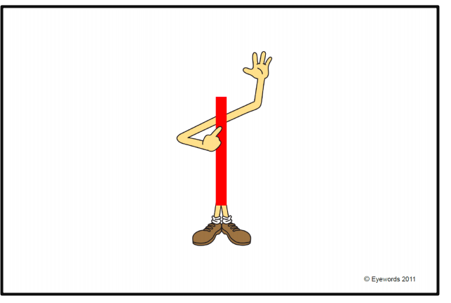
I- I did it!

Slide 3
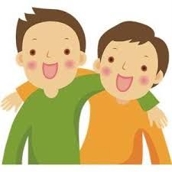
we
W-e w-e w-e , we we we.

Slide 4
can
Can c-a-n I can read.

Slide 5
a

Slide 6
the
The t-h-e, the t-h-e.

Slide 7
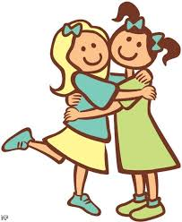
like
I like you, you like me, I spell like
L-i-k-e.

Slide 8
to
T-o- to, t-o to

Slide 9
am

Slide 10
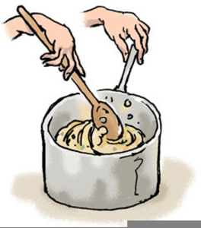
is
I-s, i-s, i-s, is.

Slide 11
my
My feet are low, my hands are high
And this is how we spell my,M-y m-y.

Slide 12
my
See, s-e-e, I see you

Slide 13
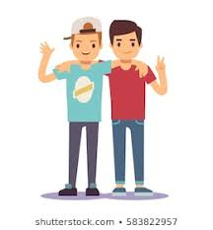
and
a-n-d, a-n-d, a-n-d , you and me!

Slide 14
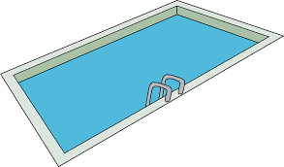
in
i-n, i-n, I go in the pool.

Slide 15
little
L-i-t-t-l-e, little, little, l-i-t-t-l-e
I can spell little.

Slide 16
at
A-t, a-t, I dance at the party.

Slide 17
with
W-i-t-h- I play with a ball.

Slide 18
with
Go- g-o, gotta go!

Slide 19
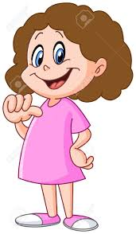
me
It’s all about me, me, m-e!

Slide 20
here
Here- h-e-r-e, Come here.

Slide 21
an

Slide 22
look
L-o-o-k, I look at you!

Slide 23
look
A-r-e, Are!

Slide 24
he
H-e, h-e, h-e, he, he, he!

Slide 25
he
B-i-g- that is so big!

Slide 26
it
I-t, i-t, it is rainy!

Slide 27
said
There is a word that I know and said
Is its name-o. S-a-i-d, s-a-i-d, s-a-i-d
And said is its name-o.

Slide 28
you
Y-o-u, I love you.

Slide 29
she
Spelling she is easy, s-h-e.

Slide 30
as

Slide 31
for
F-o-r, this cupcake is for you.

Slide 32
no
no-no.

Slide 33
one
Straight line down, then your done
That’s the way to make a 1 (o-n-e)

Slide 34
two
Around and back and on the track
Choo, choo, two two (t-w-o)

Slide 35
three
Around the tree around the tree
That’s the way to make a three
(t-h-r-e-e)

Slide 36
four
Straight line down and over once more
That’s the way to make a four
(f-o-u-r)

Slide 37
five
Straight line down then around,
Hat on top and fives a clown (f-i-v-e)

Slide 38
red
R-e-d, r-e-d, I can spell red, I can spell red. Firetrucks are red, stop signs are red, r-e-d.

Slide 39
blue
B-l-u-e spells blue, b-l-u-e spells
Blue, hi-ho what do you know, b-l-
u-e spells blue.

Slide 40
yellow
yellow, yellow -y-e-l-l-o-w.

Slide 41
green
G-r-e-e-n, green as the grass is
G-r-e-e-n, a caterpillar is green.

Slide 42
orange
.
Ora-nge, ora-nge, ora-nge, pumpkins
are always orange.

Slide 43
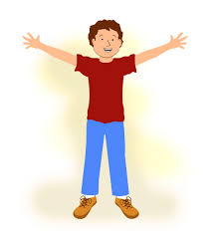
do
D-o, what should I do?
D-o, what should I do?

Slide 44
was
Was that a bee, a buzzy buzzy bee
w-a-s.

Slide 45
on
There's a frog on a log o-n spells on.

Slide 46
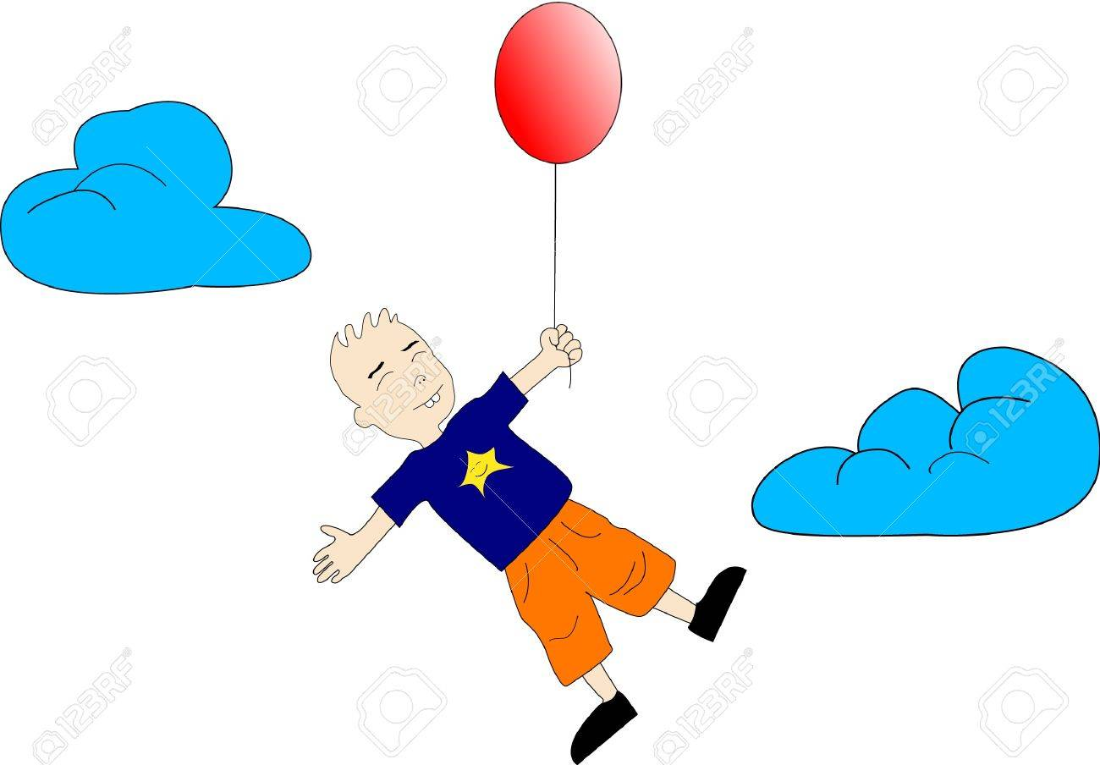
up
U-p,u-p, u-p, the balloon goes up.

Slide 47
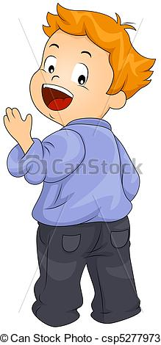
come
C-o-m-e, come along and play with me.

Slide 48
has
First you make an h then an a and an s, has, has, has,

Slide 49
be
I will always be the best that I can be , b-e.

Slide 50
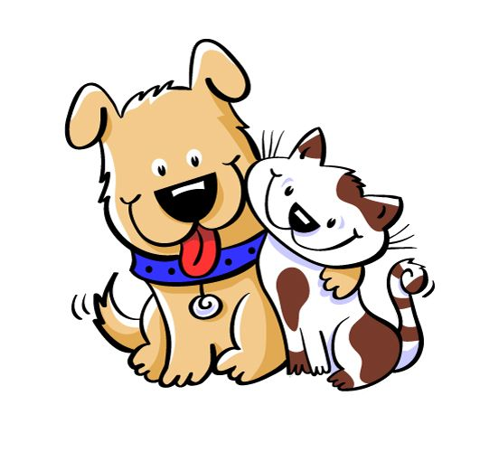
or
O-r, or, o-r-, or- do you like cats? Or do you like dogs?

Slide 51
away
Away, away, away little fly, a-w-a-y
go away.

Slide 52
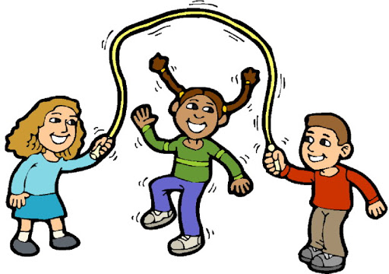
play
P-l-a-y, play, p-l-a-y, play, lets all play now, lets all play now, p-l-a-y, play.

Slide 53
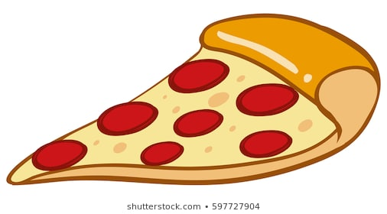
some
S-o-m-e ,some, can I have some pizza!

Slide 54
this
T-h-i-s- this is my nose.

Slide 55
by
B-y, b-y, b-y- bye, bye, bye.

Slide 56
want
I want ice cream w- a-n-t.

Slide 57
of
I can think of something- o-f.

Slide 58
what
W-h-a-t, what? W-h-a-t? What is your name?

Slide 59
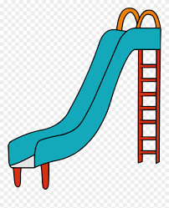
down
D-o-w-n, I go down the slide.

Slide 60
have
H-a-v-e- have- I have 2 eyes.

Slide 61
out
Go o-u-t the window, go o-u-t the window, go o-u-t the window, cus o-u-t spells out.

Slide 62
but

Slide 63
yes
Y-e-s, yes, yes, yes!

Slide 64
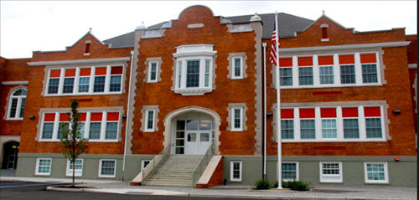
our
O-u-r, our school is the best!

Slide 65
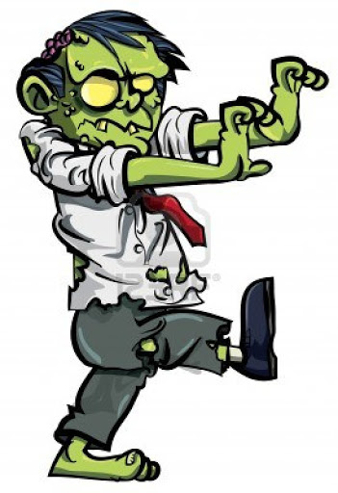
went
The zombies went like this. The zombies went like this. W-e-n-t. The zombies went like this.

Slide 66
good
G-o-o-d, good for you, good for me.

Slide 67
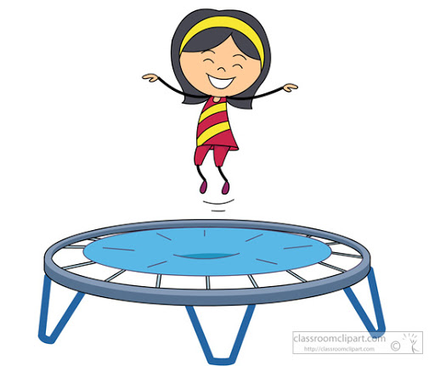
jump
J-u-m-p, I jump on a trampoline.

Slide 68
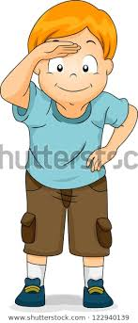
find
Find, find, find my bug f-i-n-d.

Slide 69
now
N-o-w, now, now, now!

Slide 70
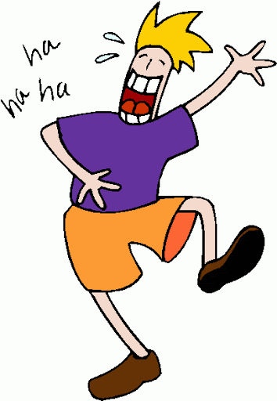
funny
F-u-n-n-y, ha, ha, ha, so funny!

Slide 71
they
They, they, they are playing, they, they, they are playing, they, they, they are playing, with
Their favorite toy.

Slide 72
help
H-e-l-p, I help you and you help me!

Slide 73
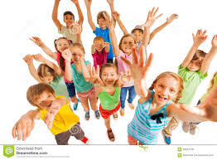
all
A-l-l spells all, all, all, all, we all shout yay!

Slide 74
from
Whose that letter from, from, from?
F-r-o-m

Slide 75
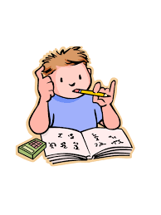
did
D-i-d, did I did, I did my homework.

Slide 76
make
Make, make, m-a-k,e- make me a cake.

Slide 77
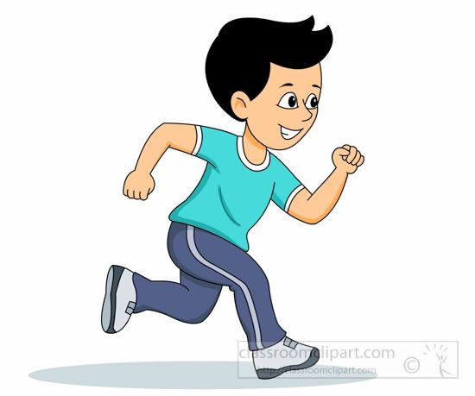
run
Run-Run, run as fast as lightening. r-u-n.

Slide 78
not
n-o-t spells not, n-o-t spells not, not not not today, not today

Slide 79
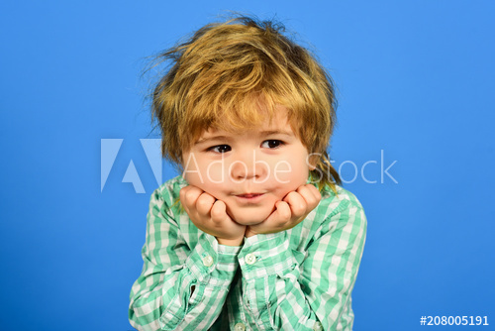
so
so, s-o, you are so cute! (put hands around face)

Slide 80
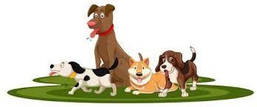
who
Who let the dogs out? W-h-o ,who?

Slide 81
get
G-e-t, get- I get some apples.

Slide 82
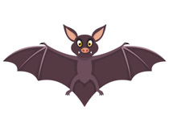
that
t-h-a-t , look at that bat.

Slide 83
under
u-n-d-e-r, under the bed.

Slide 84
his
First you make an h then an i and an is, his. His hat is cool.

Slide 85
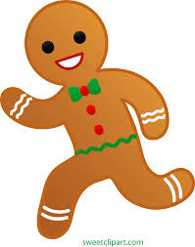
ran
The gingerbread man ran,ran,ran r-a-n.

Slide 86
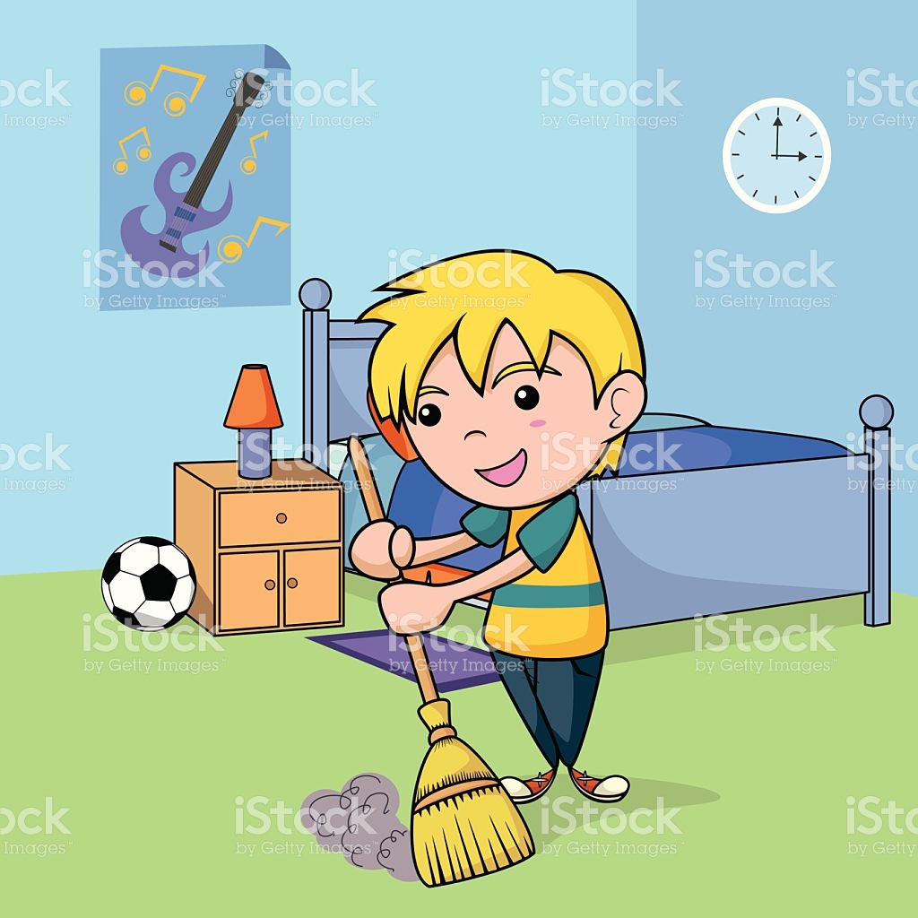
must
M-u-s-t , I must clean my room.

Slide 87
came

Slide 88
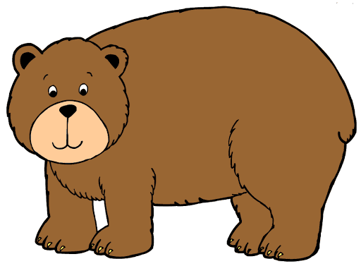
where
. Where, where oh wheres the bear? W-h-e-r-e

